Slide 1
NEURAL POETRY TO PROSE CONVERSION
GROUP NO: 19
TEAM MEMBERS
Aishik Chakraborty 13CS30041
 | |
MENTOR: Amrith Krishna

Slide 2
Introduction
Dataset consists of Sanskrit poetry-prose pairs.
Problem deals with conversion of Poetry to Prose.
Model the problem as a translation/ordering task.
Design a Seq2Seq Enc-Dec Neural Network.
Improve performance by making the model more specific to the dataset.

Slide 3
1.
DATASET

Slide 4
Ramayana Dataset
Parallel corpus in Sanskrit
18249 poetry-prose pairs
Poetry: evam uktvA tu paruzam mArIco rAvaRam tataH gacCAvaH iti abravIt dIno BayAt rAtrim cara praBoH
Prose: tataH mArIcaH evam paruzam uktvA tu rAtrim cara praBoH BayAt dInaH gacCAvaH iti rAvaRam abravIt

Slide 5
2.
Generic Seq2Seq Models

Slide 6
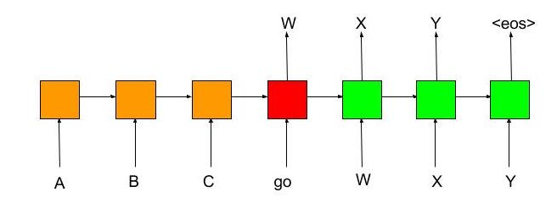
Model Architecture

Slide 7
Bi-gram Seq2Seq Encoder Decoder model with LSTMs
Embedding Size: 50
Max Sentence Length: 30 words
Optimizer: Adam
Architecture
Inp(None, X_Len) > Embed(150, 50) > LSTM(200) > Dropout(0.1) > Context > LSTM(200) > Out(None, Y_Len)

Slide 8
2) Bi-gram Seq2Seq model with pre-trained word embeddings
Embedding Size: 50
Max Sentence Length: 30 words
Optimizer: Adam
Pre-trained embeddings trained on Vedabase Sanskrit Corpus.

Slide 9
3) Bi-gram Seq2Seq model with retraining of word vectors
Embedding Size: 50
Max Sentence Length: 30 words
Optimizer: Adam
Re-trainable word embeddings matrix trained on Vedabase Sanskrit Corpus.

Slide 10
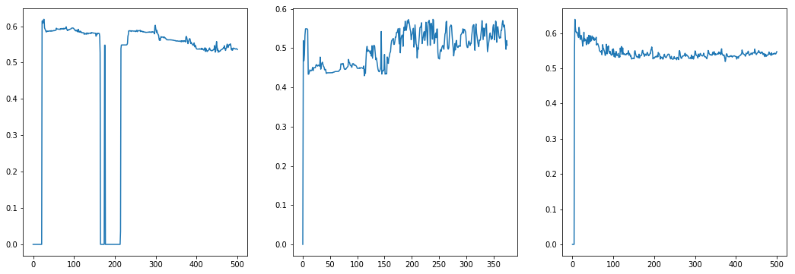
Jaro Winkler Similarity
 | Model 1 | Model 2 | Model 3
Jaro Winkler Similarity | 0.5398 | 0.5373 | 0.5414

Slide 11
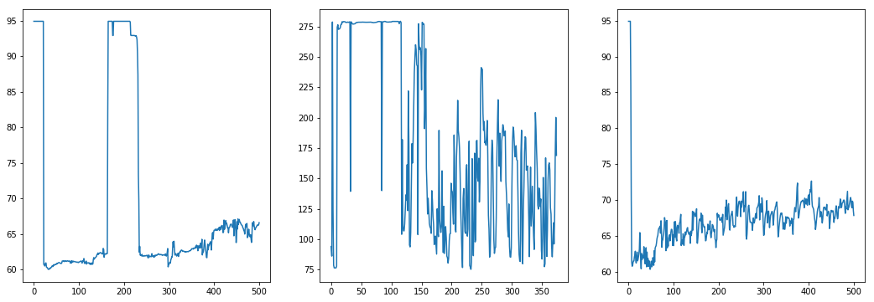
Edit Distance
 | Model 1 | Model 2 | Model 3
Edit Distance | 65.8378 | 129.2760 | 69.3470

Slide 12
3.
WORD REORDERING

Slide 13
Word Reordering
Poetry
Prose Intermediate
Poetry
NMT
Reorder
The idea is to improve the quality of generated prose by word reordering

Slide 14
Generating Word Reordering Dataset
We consider 2 cases of reordering.
Output is reverse of Input words [Simpler Task]
Split Prose dataset into :
17k(training) | 1k(testing)
Output is a random permutation of input words [Harder Task]
Split Prose dataset into(100 permutations/point) :
1.76M(training) | 260k(testing)

Slide 15
Preprocessing
Subword BPE Encoding:
Encodes rare and unknown words as sequences of subword units.
Reduce vocabulary size
Initial vocabulary size
Raw Sanskrit vocabulary : ~62k
BPE Encoded vocabulary: ~9k

Slide 16
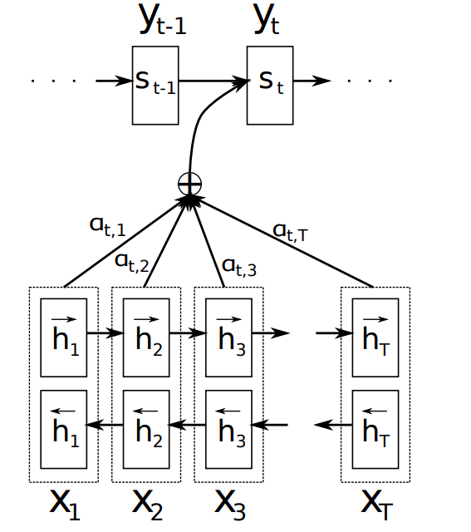
Architecture
Both Encoder and Decoder are built with GRU Cells.
We use beam search for decoding

Slide 17
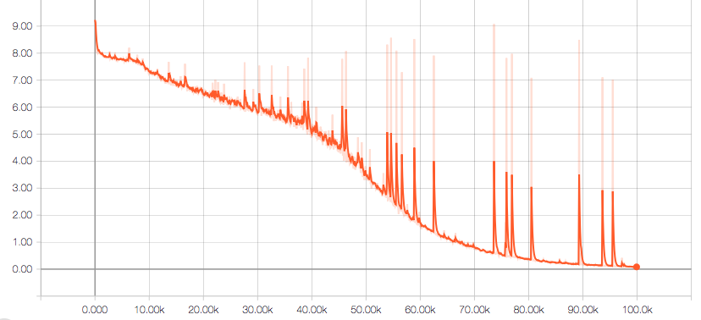
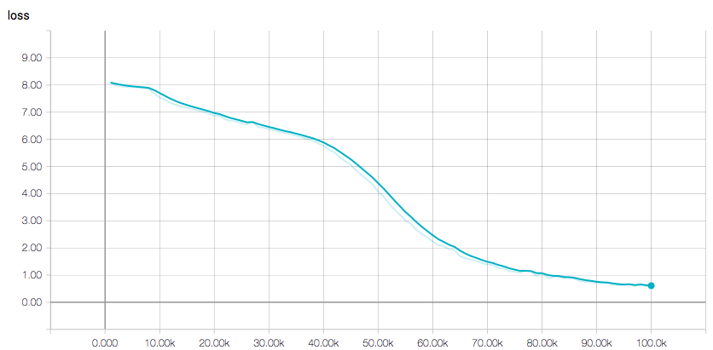
Training of reverse
Hyperparameters (tuned on validation):
Dropout: [0.1, 0.4] 0.2
Learning Rate: [0.0001, 0.01] 0.0001
Optimizer: Adam

Slide 18
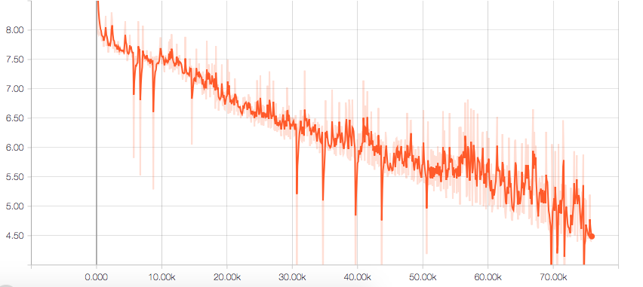
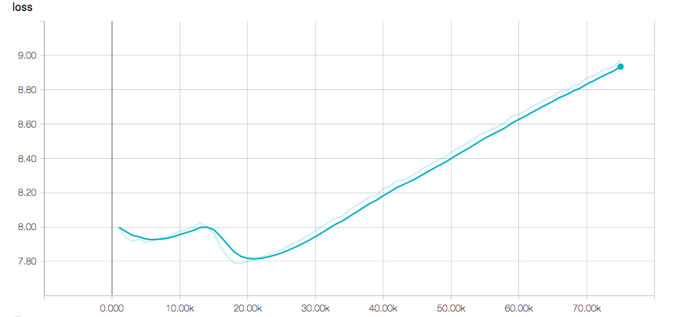
Training of random
Hyperparameters (tuned on validation):
Dropout: 0.2
Learning Rate: 0.0001
Optimizer: Adam
Problem: Overfitting !

Slide 19
Results
Orientations | BLEU
Reverse | 80.1
Random | 0.2

Slide 20
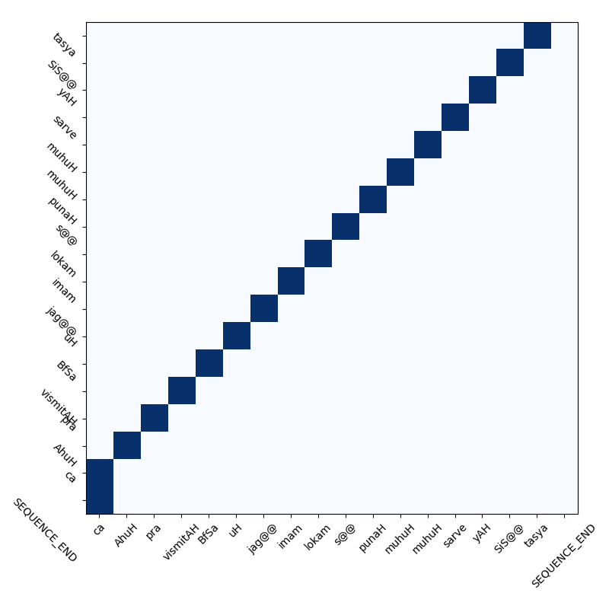
Visualizing Attention

Slide 21
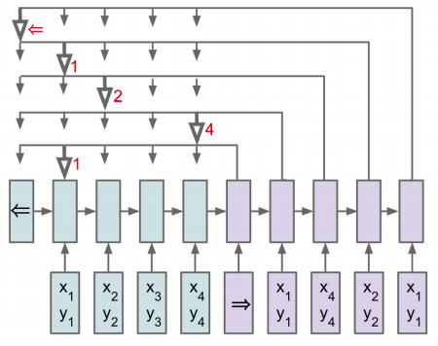
Pointer Networks
Categorical accuracy 10% only (input length 5 and 10)
Doesn’t work with variable length sequences.
Prediction becomes worse for longer sequences

Slide 22
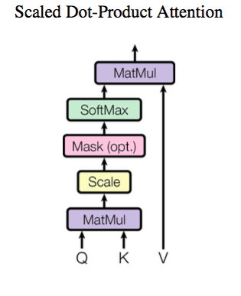
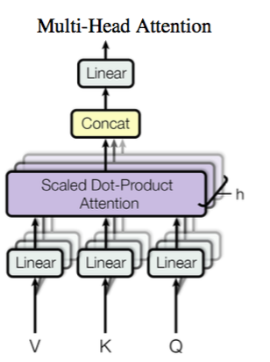
Transformer Networks

Slide 23
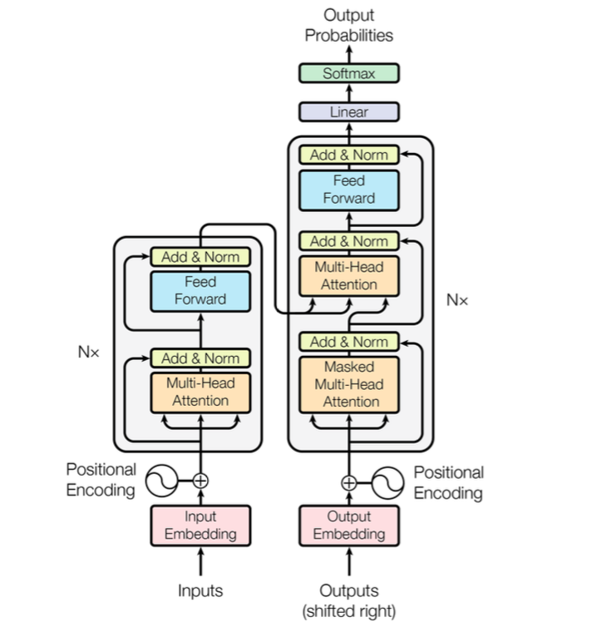
Transformer Networks

Slide 24
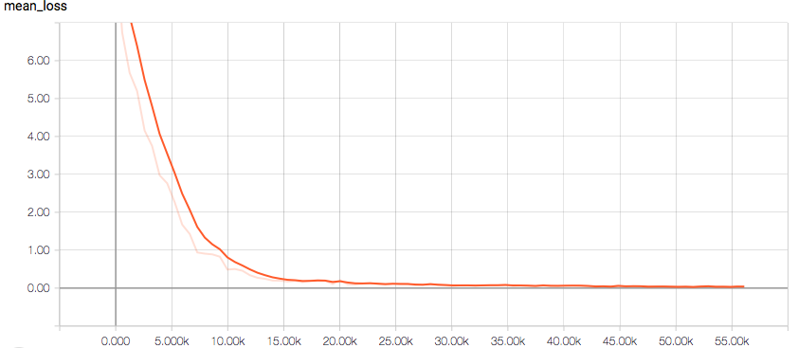
Transformer Networks
 | BLEU | WER
Transformer Network | 74.14 | 0.3

Slide 25
Some sample outputs
Source prose text:
samsayah tasya idam me yamca bavizyati saj@@ danuh ah duhita kurute nar@@ barya udyamya na
Target prose text:
nar@@ ah udyamya idam danuh kurute saj@@ yamca tasya me duhita bavizyati barya na samsayah
Predicted prose text:
nar@@ ah udyamya idam danuh kurute saj@@ yamca tasya me duhita bavizyati barya na samsayah

Slide 26
Some incorrect outputs
Source prose text:
sukam visr@@ atmana ahar@@ z@@ prahar@@ pascat ara kars@@ abdam antar ite yami artena i kfta rame barya
Target prose text:
pascat barya ahar@@ ara kars@@ ite rame kfta artena antar atmana sukam visr@@ abdam prahar@@ i z@@ yami
Predicted prose text:
pascat barya ahar@@ ara kars@@ ite karma svayam karya prahar@@ abdam prahar@@ i kfta artena antar atmana sukam

Slide 27
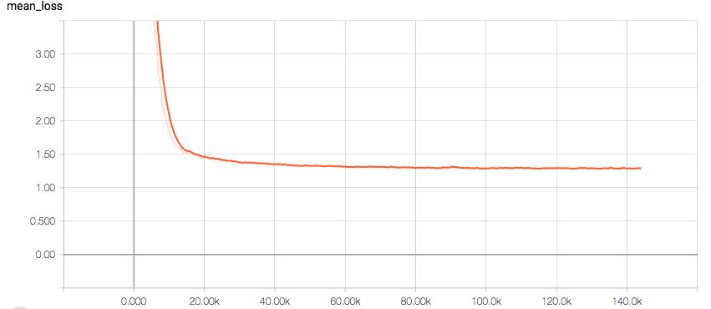
Transformer Networks for Poetry->Prose ?
BLEU Score 2.61 with 300 epochs of training

Slide 28
Some sample outputs
Source poetry text:
SIGram vyA diS a no rAjan vaDAya ezAm durAt man Am nipat antu hatAH ca ete DaraRyAm alpa jIv itAH
Target prose text:
rAjan SIGram vaDAya eShAm durAt mAm hatAH alp acet anAH nipat ant i yAvat DaraRyAm
Predicted prose text:
rAjan <UNK> param tapaH rakz antu DaraRyAm vy Al inaH naH SIGram sam diS antu DaraRyAm nyapatat
Not Great !!
Main bottleneck is training data size.

Slide 29
Future Work
Try out reordering as a part of end-to-end translation model
Tryout diifferent connections in Transformer network.

Slide 30

Thanks!
Any questions?

